Slide 1
Probation
Concept:
Basic Java:
Java Threads:
Design Pattern:
Java 8:
Hibernate
Spring
Karaf
HTML/HTML5
CSS/CSS3

Slide 2
Probation
Concept:
10. JavaScript
11. Jquery
12. AngularJS
Big Exercises: Music Manager System

Slide 3
Basic Java
Understand about:
Classes, Fields, Method.
Object, Object References
Primitive Data Types and Wrapper Data Type
Learning about:
Operators
Flow Controls, Collection

Slide 4
Basic Java
Basic OOP:
Class and instances
Characteristics: Inheritance, Polymorphism, Abstraction, Encapsulation
Access Modifiers
Association
Override & Overload
Abstract Class & Interface
Covariant Return Type

Slide 5
Java Threads
Life cycle of thread: new, runnable, waiting, timed waiting, terminated
Synchronizing Codes
Deadlock

Slide 6
Design Pattern
Adapter Pattern
Singleton Pattern
Factory Pattern
Abstract Factory Pattern
Observer Pattern
State Pattern
Strategy Pattern

Slide 7
Java 8
Lambda Expression
Method reference
Stream
forEach
String Joiner
Optional Class

Slide 8
Hibernate
Understand: ORM, Hibernate and why use Hibernate
Architecture of Hibernate
Association and Collection Mapping
Annotations and Mapping File Config
Hibernate Life Cycle
Transaction Management
HQL(Hibernate Query Language) and Native Language
Hibernate Caching

Slide 9
Spring
Understand Spring
Spring Architecture
Dependency Injection: IoC Container, Setter DI, Constructor DI,
Factory Method
Autowiring
Spring with Hibernate

Slide 10
Karaf
Understand OSGI, Karaf and Karaf’s Bundle
Karaf Architecture.
Start/stop and deployed a bundle
Learning about: Karaf blueprint, Karaf bundle, Karaf jdbc, Karaf JPA, Karaf Maven, Karaf war, Karaf RESTFul.

Slide 11
HTML/HTML5
HTML Syntax
HTML Tags
HTML File Path
HTML5 Layout: header, nav, section, aside, footer, article] tag
HTML Responsive
HTML5 new tag: audio, sgv, video, canvas,...
Media: video, audio, plugins: embed and object tag, youtube embed.
Geolocation, Drap&Drop
Storage: Web Storage, Local Storage, Session Storage

Slide 12
CSS/CSS3
Understand CSS/CSS3
Syntax of CSS/CSS3
Understand to insert CSS/CSS3 in project
CSS3 Box Model
Learning some CSS attribute for text, link, list, font, table, form
CSS Selector
CSS3 animation
CSS3 box sizing
Learning about Bootstrap, Font AweSome

Slide 13
JavaScript
Understand JavaScript
Syntax of JavaScript
Variable
DOM events
Method about string, number, array
Query DOM( Finding HTML elements by [ id, class, name, tag name, css selector ])
JSON and XML
Callback
Object, Function and Scope

Slide 14
JavaScript
Timeout and Interval
Prototype

Slide 15
Jquery
Understand jquery
Selectors: All selector starts with $
Events: Mouse, Keyboard, Form, Document
jquery CSS: add, remove and toggleClass() and css()
AJAX: load(), get() and post() method
Effects

Slide 16
AngularJS
Understand AngularJS and its concepts
Directives: ng-app, ng-model, ng-controller, ng-init, ng-click,... and custom a directive
Databinding: use ng-bind directive or {{expression}}
MVVM Model
Scopes, Service, Module
Filter and custom a filter
Angular config
APIs of angularJS: ngRoute, ngAnimate,...

Slide 17
Big Exercise: Music Manager System
Overview:
Music Manager System allows you to browse through a music library. You can add new entries(Song) and delete them and CRUD
Music will be stored server side in database. The client will communicate with server via web client use RESTFul API.
On Server Side, we will develop by Karaf JPA and use Hibernate for database.
On Client Side, we will develop by AngularJS Application with Bootstrap 3.3.7, jquery, JSON

Slide 18
Big Exercise: Music Manager System
2. Server-Side:
We will build server side based on the example of Karaf RESTFul:
Project API: includes Entity and interface Entity Service
Project service: include DAO and Service Implement API
Project RESTFul: define RESTFul API services based on project API
Project Feature: define feature to use in karaf command
Four project are maven project and will be managed by a big simple Maven project

Slide 19
Big Exercise: Music Manager System
2.1. Project API:
We built a maven project use dependency persistence to define Entity.
Create a package, includes: Song Entity and SongService:
Song Entity (persistence entity): includes fields: id, name, genre, lyrics and getor, setor, constructor of them.
SongService is a interface have methods such as:
list(): show all list Song in database
get(int id): get a song by id
add(): add a new song
update(): update a song

Slide 20
Big Exercise: Music Manager System
2.1. Project API:
SongService is a interface have methods such as:
remove and removeAll method: delete a song by id and delete all song in list song.
getbyName(): select list song by query name
getCountListSong(): get sum of list song
getSongPagination(): get song to use for pagination

Slide 21
Big Exercise: Music Manager System
2.2. Project service:
Project service use dependencies, such as: persistence, transaction.
In project, we will create 2 package:
DAO package, includes:
SongDAO interface(it have methods same as interface SongService of Project API)
SongDAOImpl class: Implement interface SongDAO.
Service package, includes:
SongServiceImpl class: Implement interface SongService, use method of SongDAO.

Slide 22
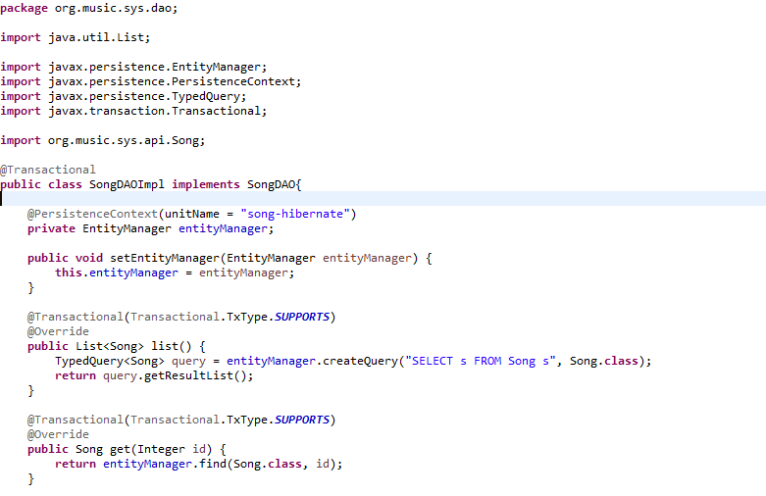
Big Exercise: Music Manager System
2.2. Project service:
SongDAOImpl class: Use Hibernate - JPA to communicate with database
Create Persistence to use for JPA Database and create a EntityManager to use query
Define list method by query use HQL to get list song in database

Slide 23
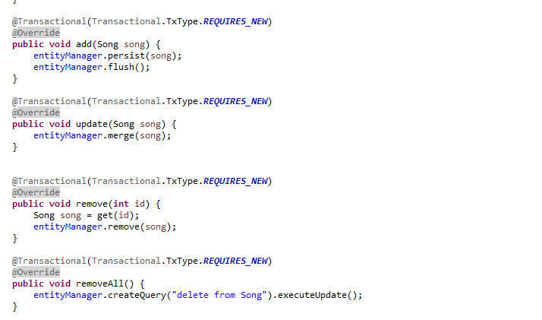
Big Exercise: Music Manager System
2.2. Project service:
SongDAOImpl class: Use Hibernate - JPA to communicate with database
Define method add, update, remove, removeAll by HQL
The TxType element of the annotation indicates whether a bean method is to be executed within a transaction context where the values provide the corresponding behavior, such as REQUIRES_NEW, SUPORT

Slide 24
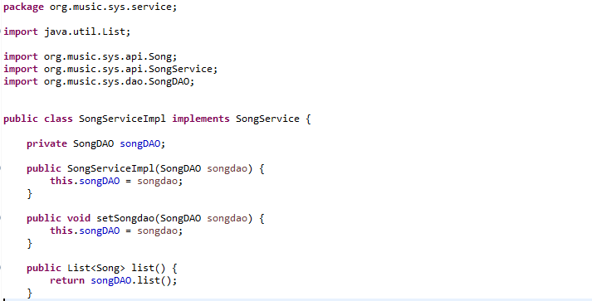
Big Exercise: Music Manager System
2.2. Project service:
SongServiceImpl: In package service, this class implement interface SongService of Project API and body method will use method of SongDAO, sample:
Declare SongDAO as field. And define it in constructor
list() method return list() method of songDAO

Slide 25
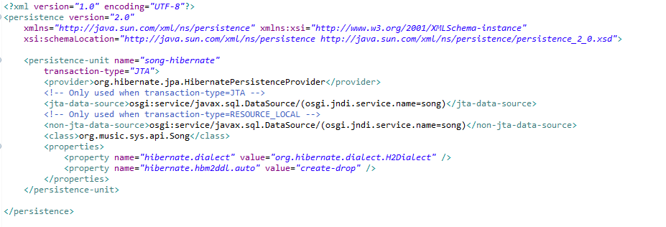
Big Exercise: Music Manager System
2.2. Project service:
To Service Project communicate with database, we define persistence in resource sure JPA to use
Define transaction is JPA or not, use class Song is Table, and define use hibernate

Slide 26
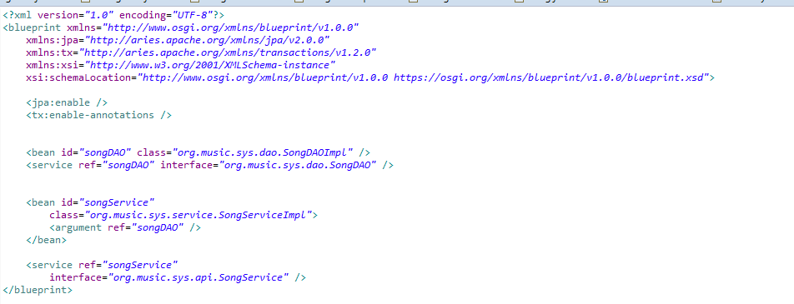
Big Exercise: Music Manager System
2.2. Project service:
We define bean to sure that classes are used to communicate with JPA.
Register class into bean

Slide 27
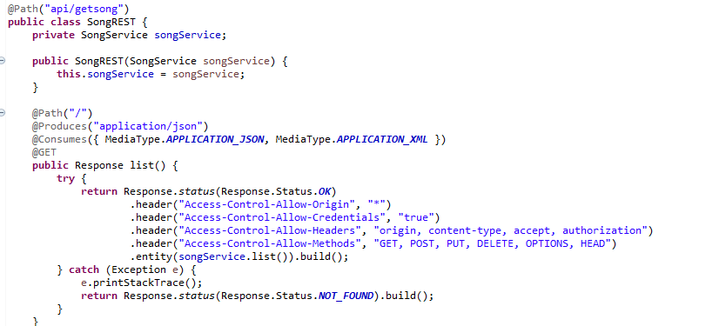
Big Exercise: Music Manager System
2.3. Project RESTFul:
To create a RESTFul project will need use javax.ws.rs.* library.
Create a package and class in the package, we have:
Path address API addition
Create a Response function
Header Response
method list() of SongService to use to respone data

Slide 28
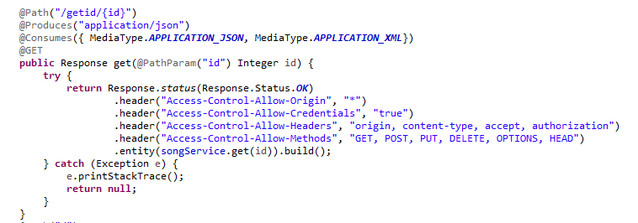
Big Exercise: Music Manager System
2.3. Project RESTFul:
The same, we have response update, get, getbyName, deleteAll, getCountListSong, getPaginationListSong uses update, get, getbyName, deleteAll, getCountListSong, getPaginationListSong method of SongService

Slide 29
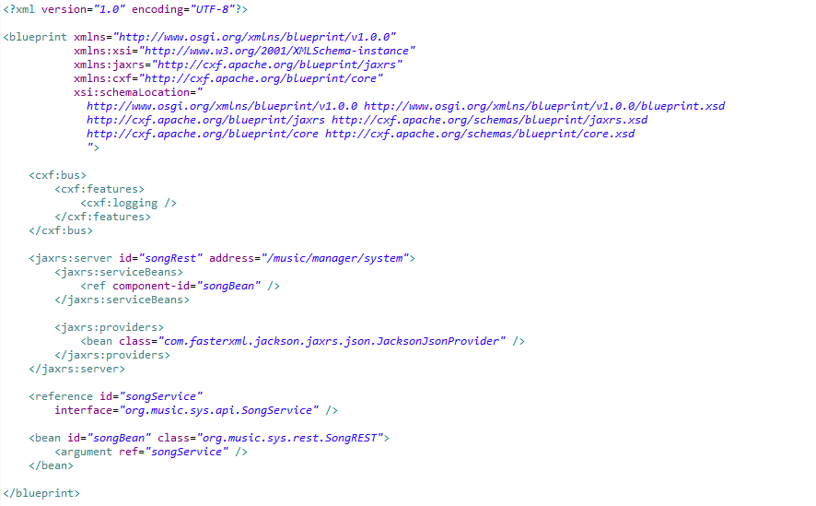
Big Exercise: Music Manager System
2.3. Project RESTFul:
Finally, we need to define RESTFul.xml to register address, service and bean to work.

Slide 30
Big Exercise: Music Manager System
2.4. Project Feature:
Base on Karaf feature RESTFul project, we define a same project with feature file about:
Define Datasource: create Database and use Datasource Name we define in Project Service
Define feature API: use Hibernate and deploy bundle form Project API
Define feature Service: Deploys feature API and project Service
Define feature RESTFul: Use feature API and Service and dependency bundle jackson

Slide 31
Big Exercise: Music Manager System
2.5. Check API:
We install Project we build. But first, we need install feature cxf to feature rest working, because rest use jackson, jaxrs, but they are a part of cxf.
After install in karaf, we check API in PostMan Application.

Slide 32
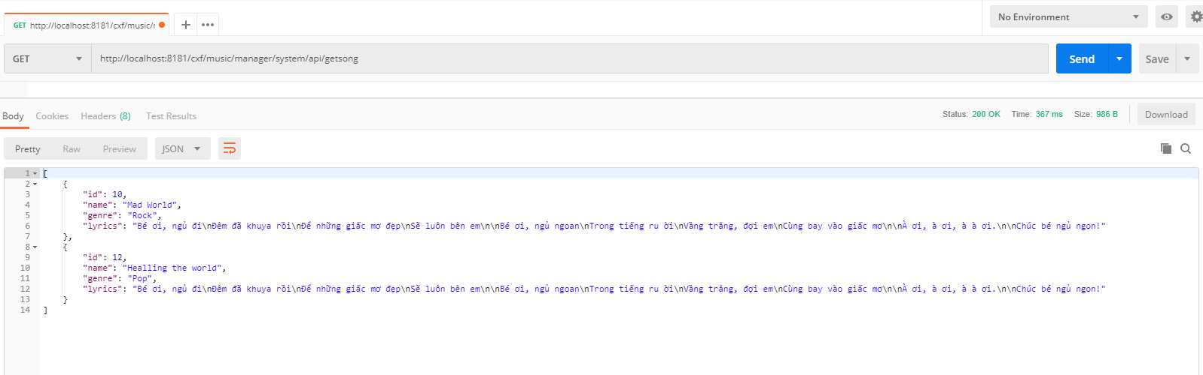
Big Exercise: Music Manager System
2.5. Check API:
Example, we check get list method after we have data

Slide 33
Big Exercise: Music Manager System
3. Client-Side:
Based on Karaf Example of War Project, we build a Karaf project Client-Side with HTML5/CSS3, AngularJS, Bootstrap, Jquery and Font Awesome, Material Dialog, Material Tooltip and Material Pagination.
In project, we have:
Home Page: Show list songs with actions
Home Clone Page: A copy of Home page with new Pagination
Edit Page: Edit a song when user selected
Add pop-up and Play pop-up: show in Home page after use choose add or play button.
Controllers for pages and config for project
Service: load list song, save a song and add song

Slide 34
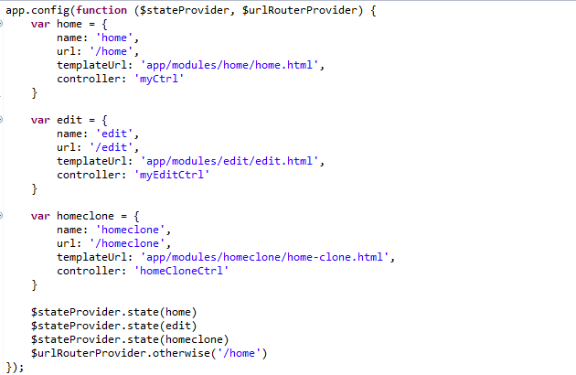
Big Exercise: Music Manager System
3. Client-Side:
Config file:
app.js: define module app
app.routing.js: config router pages use ui.router

Slide 35
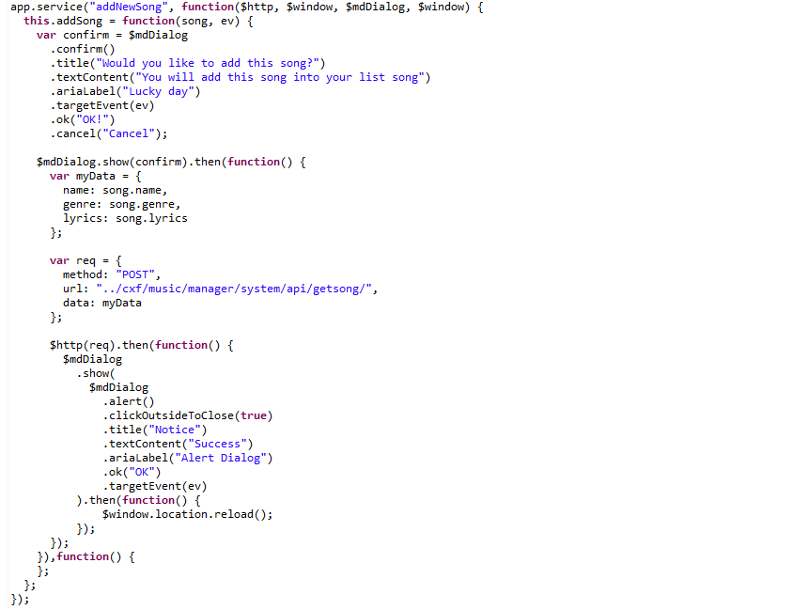
Big Exercise: Music Manager System
3. Client-Side:
Service:
Add service: use $http post to communicate with RESTFul API to add new record for API and use material to show dialog.

Slide 36

Big Exercise: Music Manager System
3. Client-Side:
Service:
Load service: use $http get to communicate with RESTFul API to get list song in API.

Slide 37
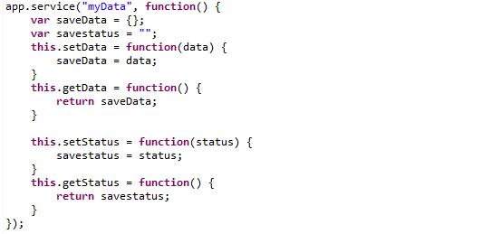
Big Exercise: Music Manager System
3. Client-Side:
Service:
Data service: used to save a data a song and status for Edit Page.
Status: to Edit page know that home page or home clone page communicate with it
Data: a song need to edit

Slide 38
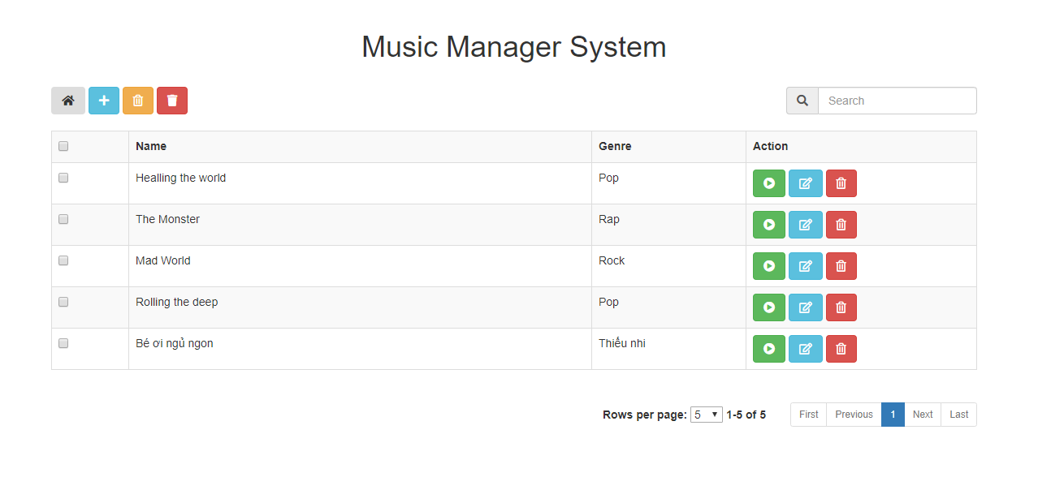
Big Exercise: Music Manager System
3. Client-Side:
Home Page:
Actions, such as: Home Clone, Add new song, delete song, delete All
Search song in the list song
The Actions in a record: play, edit and delete a song
Pagination

Slide 39
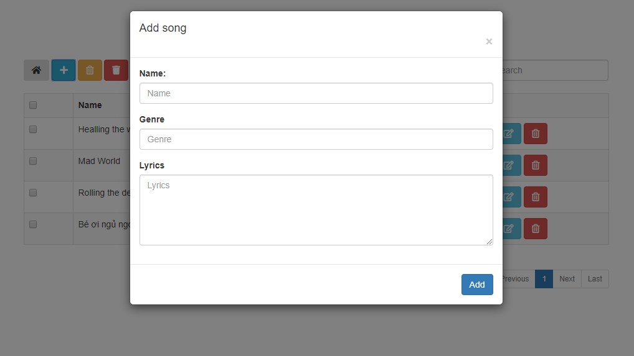
Big Exercise: Music Manager System
3. Client-Side:
Home Page:
Add pop-up: Fill out information in all field and click add to save
Action Add use add service

Slide 40
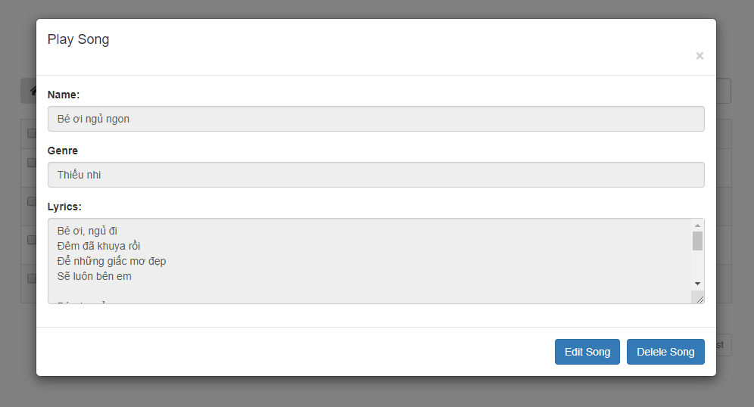
Big Exercise: Music Manager System
3. Client-Side:
Home Page:
Play pop-up: Play a song when user click play button.
Go to Edit Page to edit this song
Show warning, communicate with RESTFul API to delete by id

Slide 41


Big Exercise: Music Manager System
3. Client-Side:
Home Page:
Search: Use ng-model and filter to search song
Actions in a record: Play, Edit, Delete action will communicate with Server through AngularJS Controller(using $http service to send request to RESTFul API) to play, edit, delete a song.

Slide 42

Big Exercise: Music Manager System
3. Client-Side:
Home Page:
Pagination: use UI-Bootstrap to create a Pagination

Slide 43

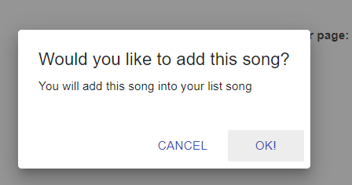
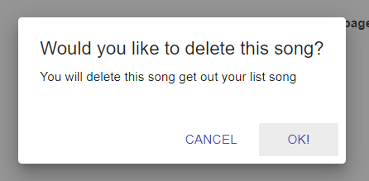
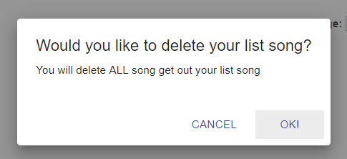
Big Exercise: Music Manager System
3. Client-Side:
Home Page:
Home Clone Button: Go to Home Clone Page
Add Button: Show pop-up add to add new song.
Delete Song: if checkbox checked, we will delete songs selected.
Delete All Song: Delete All song in list songs
In every decision, we show a dialog to notice or warning for user, such as:

Slide 44
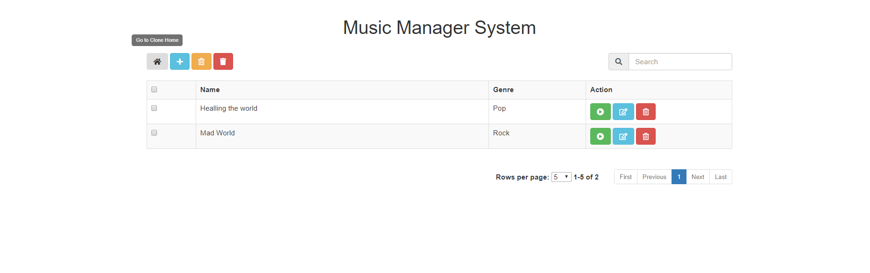
Big Exercise: Music Manager System
3. Client-Side:
Home Page: To describe for a button, we use Material Tooltip to user know that the button what is worded problems.

Slide 45
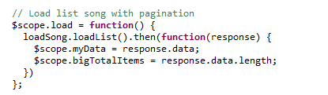

Big Exercise: Music Manager System
3. Client-Side:
Home Page Controller: Control Home Page with actions to communicate with RESTFul API.
Load List Song: Connect to RESTFul API by $http-get to get list song to show in web-app

Slide 46

Big Exercise: Music Manager System
3. Client-Side:
Home Page Controller:
Home Clone Page: Go to Home Clone Page by $state service it use for Home Clone Button

Slide 47
Big Exercise: Music Manager System
3. Client-Side:
Home Page Controller:
Delete song if checkbox checked: use $http-delete to delete a song by its id and use material dialog to warning user. This control is used for Delete Song button.

Slide 48

Big Exercise: Music Manager System
3. Client-Side:
Home Page Controller:
Actions in a record:
Play Action: use $http get to get the song in RESTFul API by id and in the pop-up have 2 actions is edit action and delete by id action. It is used for Play Action button.
Edit Action: Go to Edit page to edit a song. It use edit controller
Delete by id action: Delete a song by id of it. It use delete song by id controller.

Slide 49
Big Exercise: Music Manager System
3. Client-Side:
Home Page Controller:
Edit controller: go to Edit page use $state service and send data for Edit controller page (use data service). It use for Edit Action and Edit Action in Play Action.
Delete all song: use $http-delete communicate with RESTFul API to delete all song and use Material Dialog to warning. It is used for Delete All Song button.

Slide 50
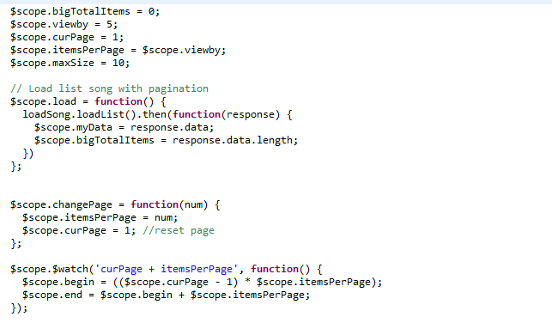
Big Exercise: Music Manager System
3. Client-Side:
Home Page Controller:
Pagination: Use UI.Bootstrap to get Directive uib-pagination to create a pagination for page.
bigTotalItems: length of list song.
curPage: current Page
itemsPerPage: number of item in a page
$watch curPage and itemsPerPage to change value of scope begin and end

Slide 51
Big Exercise: Music Manager System
3. Client-Side:
Home Clone Page: This is a copy of Home page. In clone page, we have features same as Home Page, but we will have new pagination.
Problem: If in the list song have very many songs( such as 1M songs) and to load this list will be losed a lot of time.
Solution: We create new API in RESTFul API. It is getCountListSong and getPaginationListSong to avoid load all song. We will only load list songs, we need(based on current page and items per page).

Slide 52
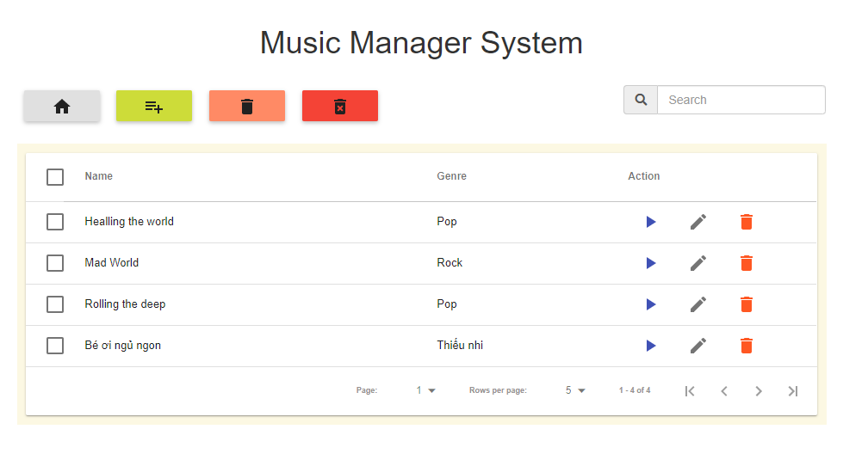
Big Exercise: Music Manager System
3. Client-Side:
Home Clone Page: We use Material Data Table design by Daniel to create Table with a new pagination.

Slide 53
Big Exercise: Music Manager System
3. Client-Side:
Edit Page:
Translate page language if user change language.
Edit a song and in its controller, based on data (a song) from Home or Home Clone page sent, Edit Page Controller will use $http-put to update the song and require all fill not blank. If user cancel, we will go to back home page.

Slide 54
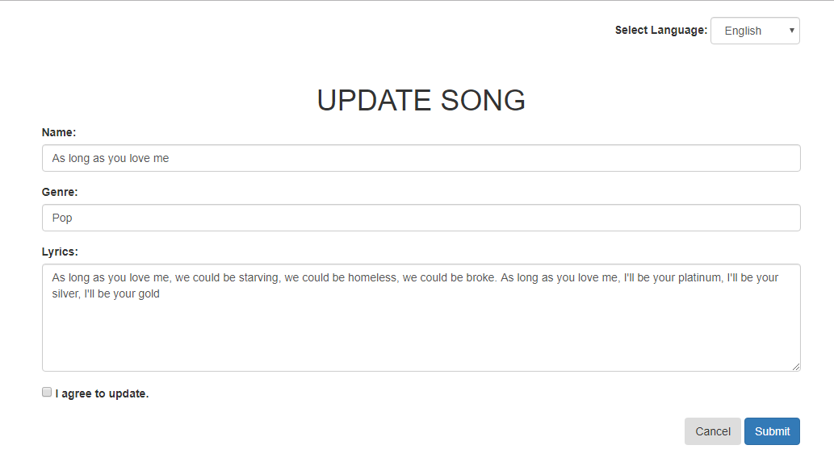
Big Exercise: Music Manager System
3. Client-Side:
Edit Page:
Select English

Slide 55
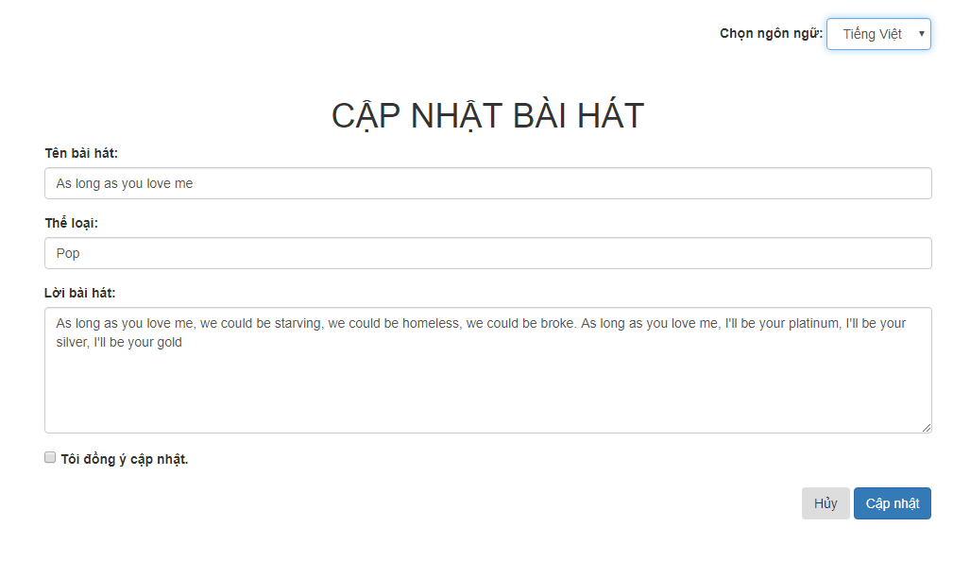
Big Exercise: Music Manager System
3. Client-Side:
Edit Page:
Select Vietnamese

Slide 56


